Slide 1
Ballistic Pendulum
Conservation of Momentum in One Direction
Experiment #7
PHYSIC 181 - Spring 2020
Dept. of Physics UMASS Boston

Slide 2
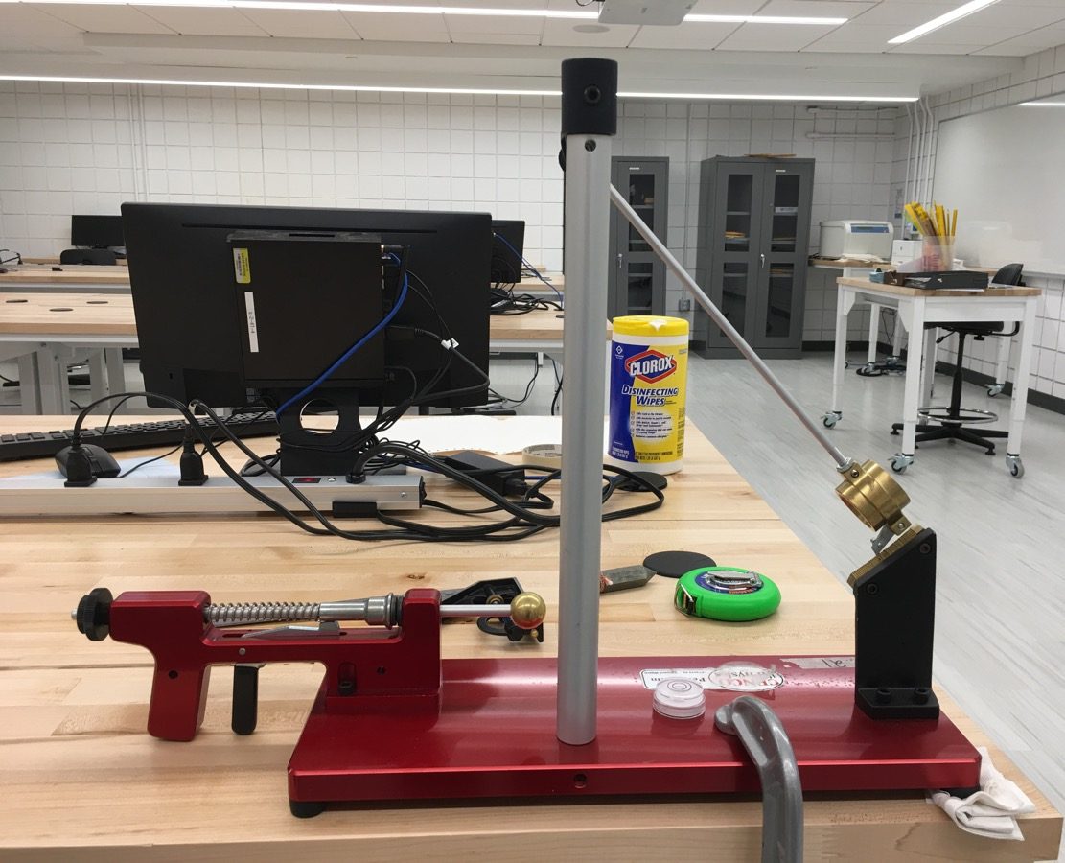
Experimental Overview
Purpose:
Verify the conservation of momentum in an inelastic collision
Apparatus:
Blackwood ballistic pendulum
Plumb bob
30 cm ruler
Measuring tape
Combination square
Mass balance
Bubble level

Slide 3
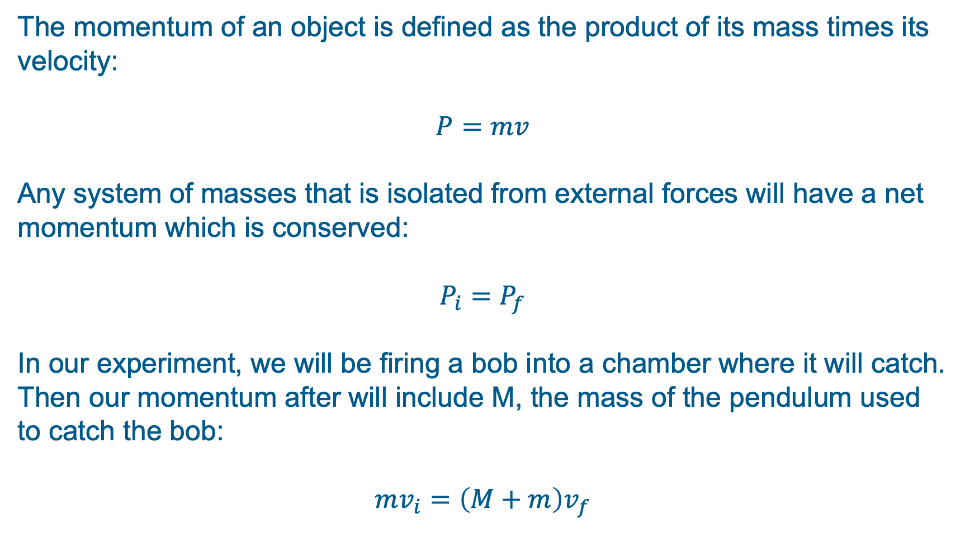
Theory
The momentum of an object is defined as the product of its mass times its velocity:
$$P=mv$$
Any system of masses that is isolated from external forces will have a net momentum which is conserved:
$$P_{i}=P_{f}$$
In our experiment, we will be firing a bob into a chamber where it will catch. Then our momentum after will include M, the mass of the pendulum used to catch the bob:
$$mv_{i}=\left(M+m\right)v_{f}$$

Slide 4
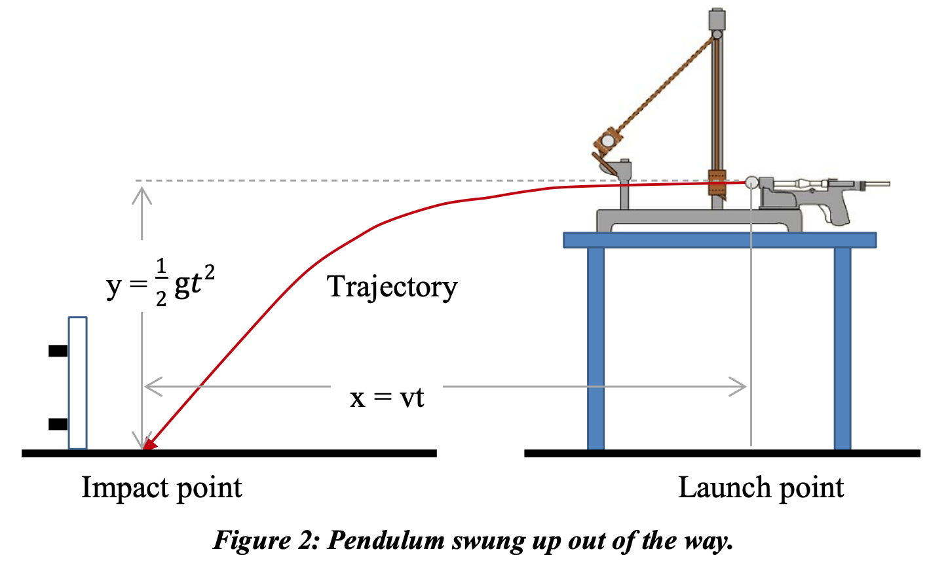
Part I – Projectile Motion
This experiment is broken into two parts to find the initial velocity and final velocity. We will find the initial velocity first by moving the pendulum out of the way so that it does not interfere with the projectile as shown below:

Slide 5
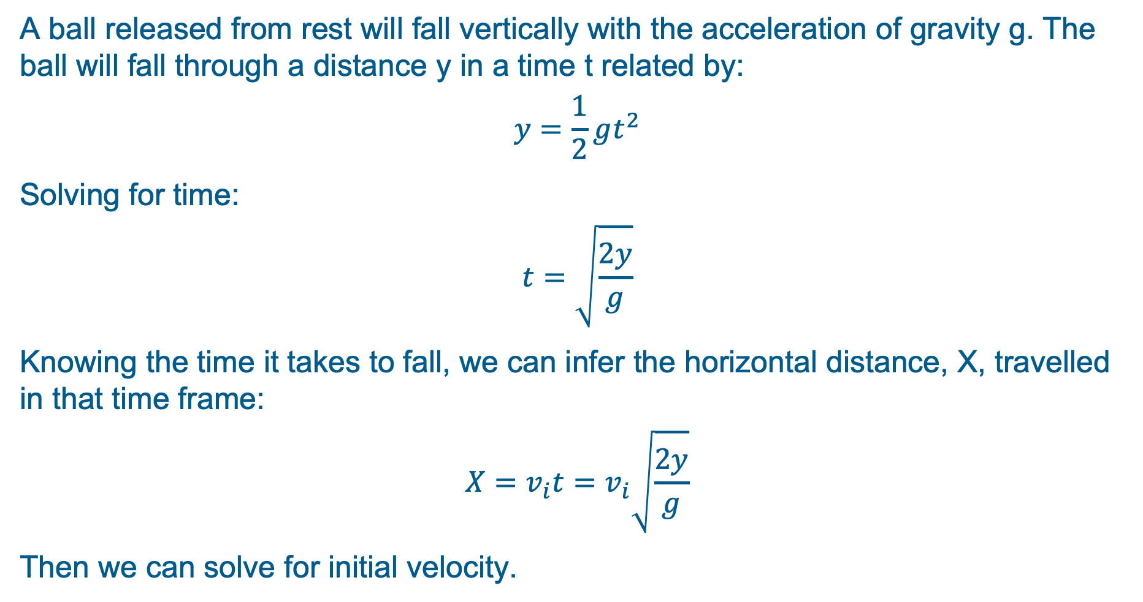
Part I – Projectile Motion
A ball released from rest will fall vertically with the acceleration of gravity g. The ball will fall through a distance y in a time t related by:
$$y=\frac{1}{2}gt^{2}$$
Solving for time:
$$t=\sqrt{\frac{2y}{g}}$$
Knowing the time it takes to fall, we can infer the horizontal distance, X, travelled in that time frame:
$$X=v_{i}t=v_{i}\sqrt{\frac{2y}{g}}$$
Then we can solve for initial velocity.

Slide 6
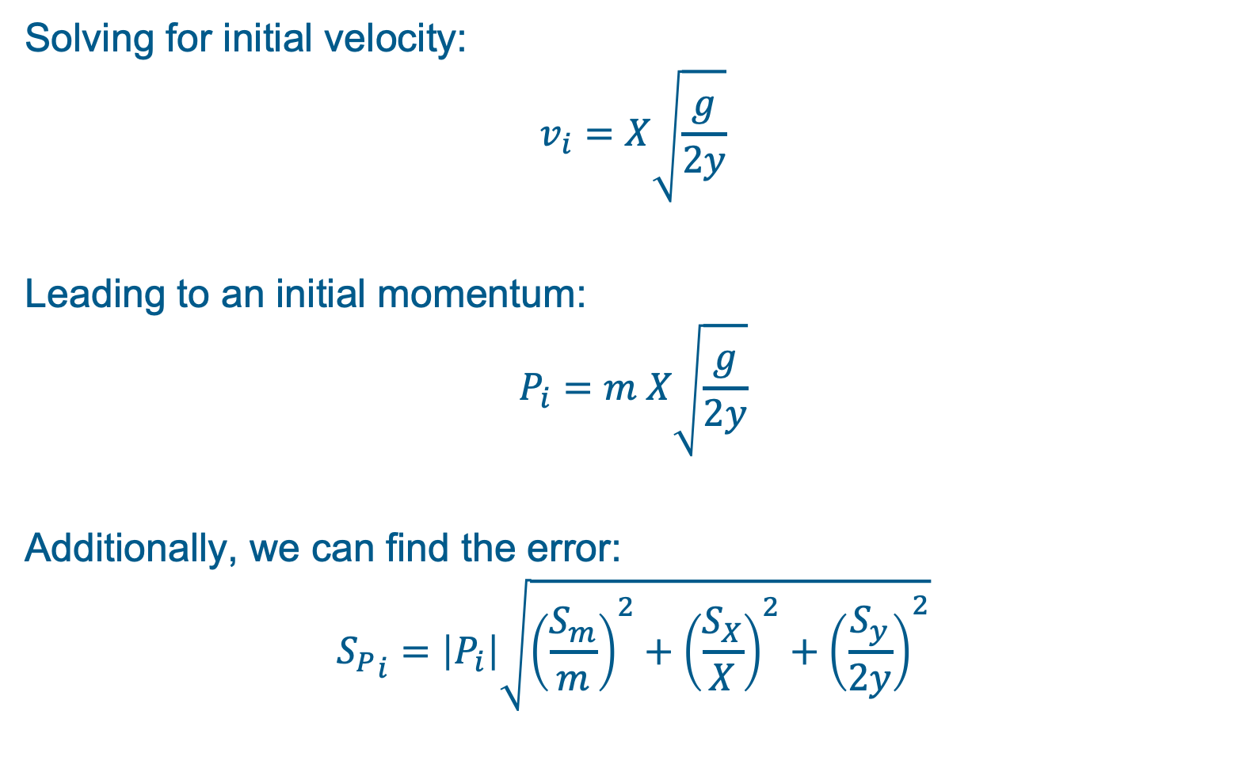
Part I – Projectile Motion
Solving for initial velocity:
$$v_{i}=X\sqrt{\frac{g}{2y}}$$
Leading to an initial momentum:
$$P_{i}=m X\sqrt{\frac{g}{2y}}$$
Additionally, we can find the error:
$${S_{P}}_{i}=\left|P_{i}\right|\sqrt{{\left(\frac{S_{m}}{m}\right)}^{2}+{\left(\frac{S_{X}}{X}\right)}^{2}+{\left(\frac{S_{y}}{2y}\right)}^{2}}$$

Slide 7
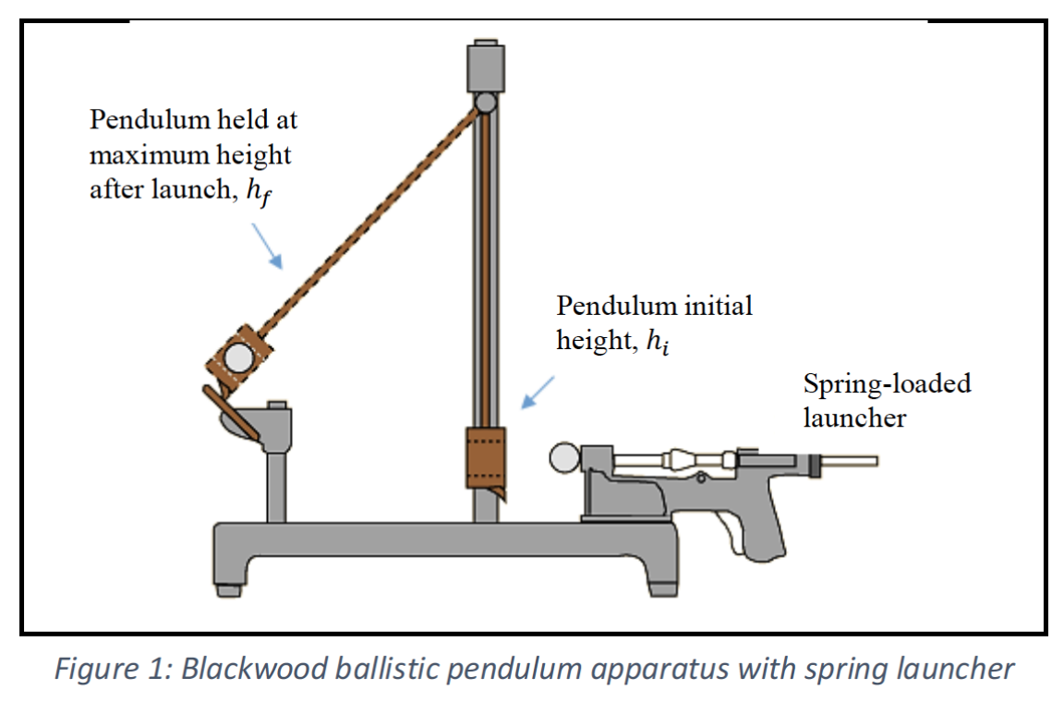
Part II – Conservation of Momentum
We can find the final velocity second using the ballistic pendulum:

Slide 8
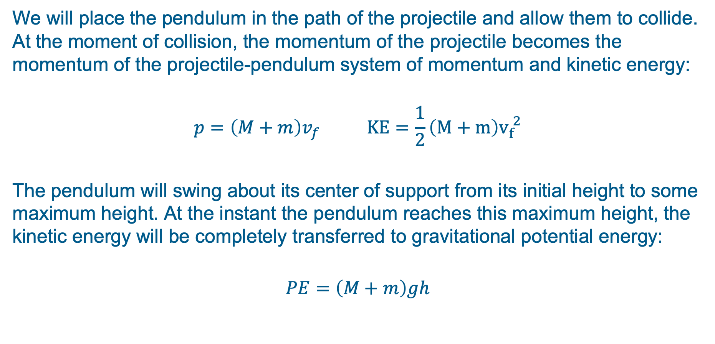
Part II – Conservation of Momentum
We will place the pendulum in the path of the projectile and allow them to collide. At the moment of collision, the momentum of the projectile becomes the momentum of the projectile-pendulum system of momentum and kinetic energy:
$$p=\left(M+m\right)v_{f} KE=\frac{1}{2}\left(M+m\right)v_{f}^{ 2}$$
The pendulum will swing about its center of support from its initial height to some maximum height. At the instant the pendulum reaches this maximum height, the kinetic energy will be completely transferred to gravitational potential energy:
$$PE=\left(M+m\right)gh$$

Slide 9
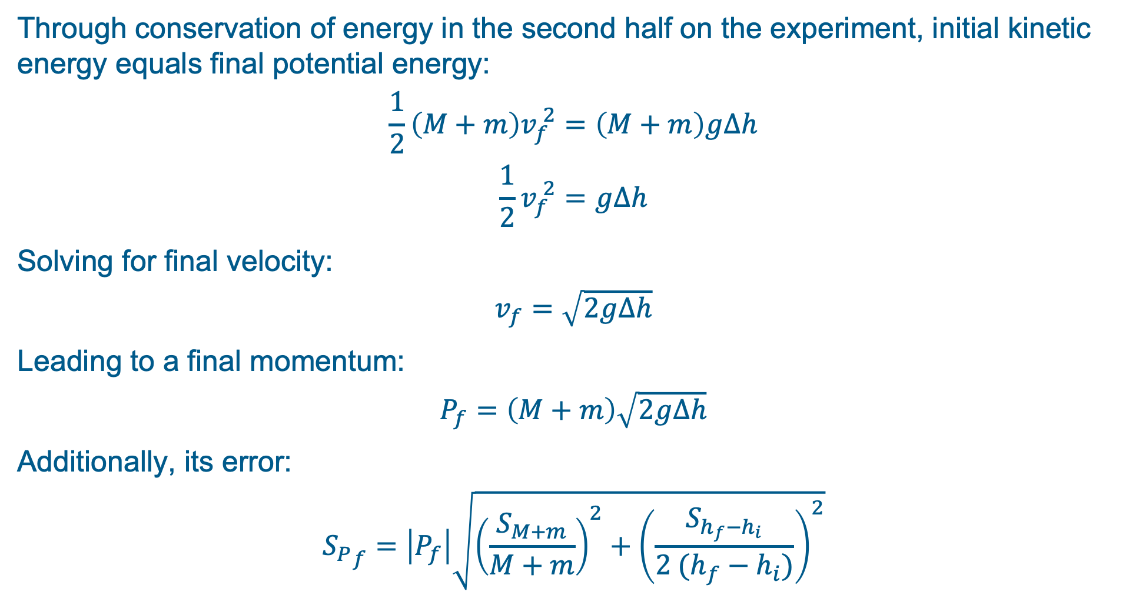
Part II – Conservation of Momentum
Through conservation of energy in the second half on the experiment, initial kinetic energy equals final potential energy:
$$\frac{1}{2}\left(M+m\right)v_{f}^{ 2}=\left(M+m\right)g∆h$$
$$\frac{1}{2}v_{f}^{ 2}=g∆h$$
Solving for final velocity:
$$v_{f}=\sqrt{2g∆h}$$
Leading to a final momentum:
$$P_{f}=\left(M+m\right)\sqrt{2g∆h}$$
Additionally, its error:
$${S_{P}}_{f}=\left|P_{f}\right|\sqrt{{\left(\frac{S_{M+m}}{M+m}\right)}^{2}+{\left(\frac{S_{h_{f}−h_{i}}}{{2 (h}_{f}−h_{i})}\right)}^{2}}$$

Slide 10
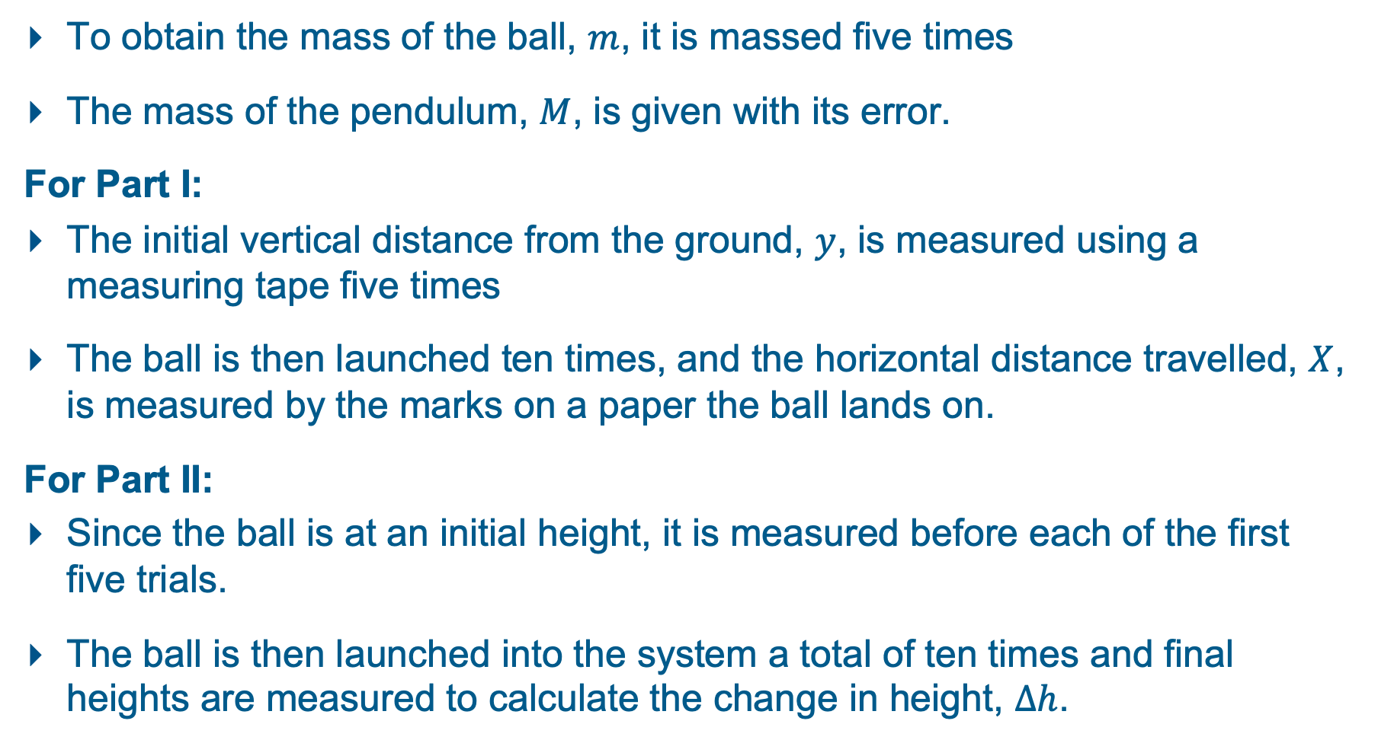
Procedure
To obtain the mass of the ball, $m$, it is massed five times
The mass of the pendulum, $M$, is given with its error.
For Part I:
The initial vertical distance from the ground, $y$, is measured using a measuring tape five times
The ball is then launched ten times, and the horizontal distance travelled, $X$, is measured by the marks on a paper the ball lands on.
For Part II:
Since the ball is at an initial height, it is measured before each of the first five trials.
The ball is then launched into the system a total of ten times and final heights are measured to calculate the change in height, $∆h$.

Slide 11
Procedure
Our experimental set-up:
MOVIE

Slide 12
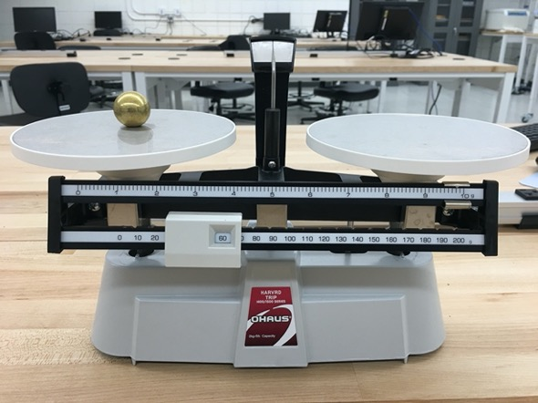
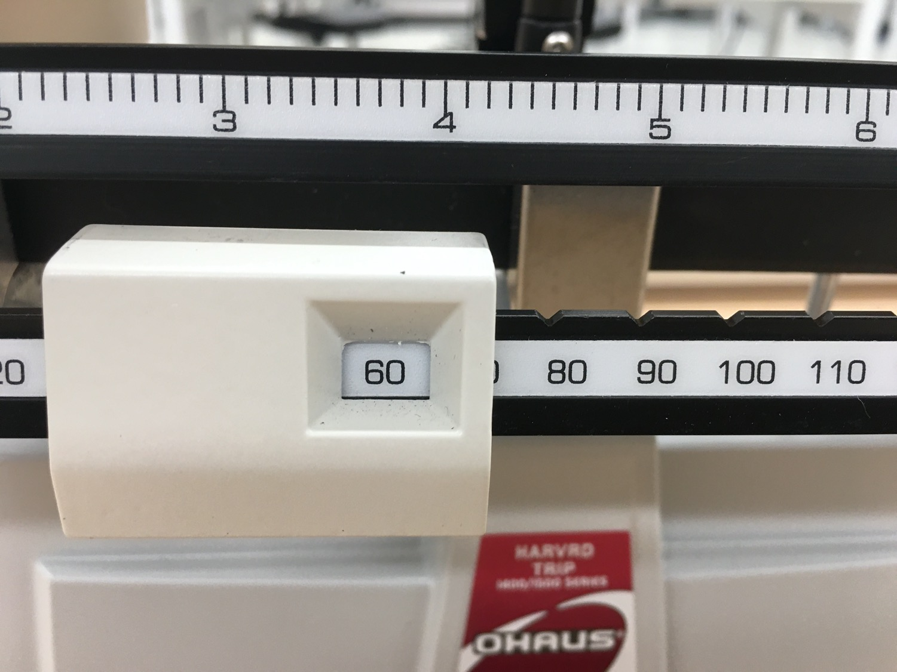
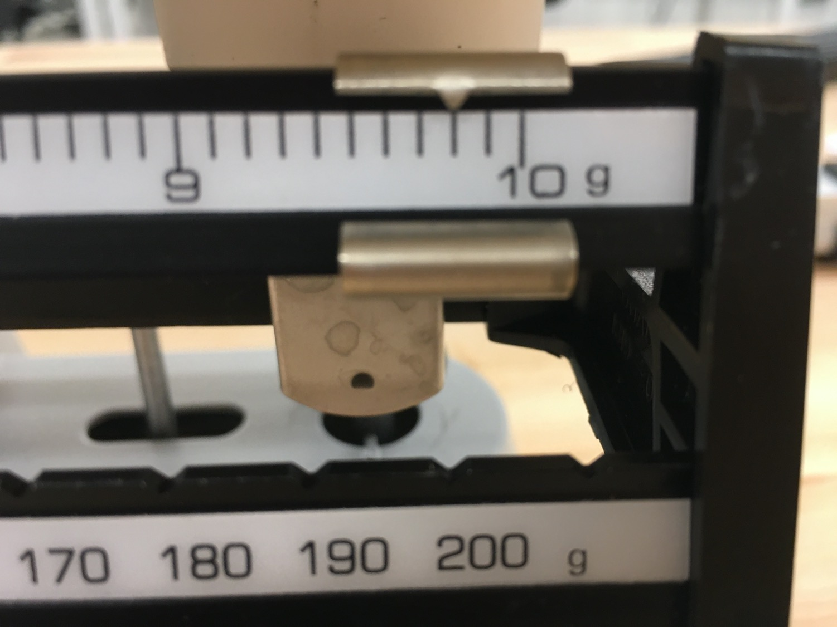
Procedure Part I – Measuring the Mass of the Ball
Take the mass of the ball five times

Slide 13
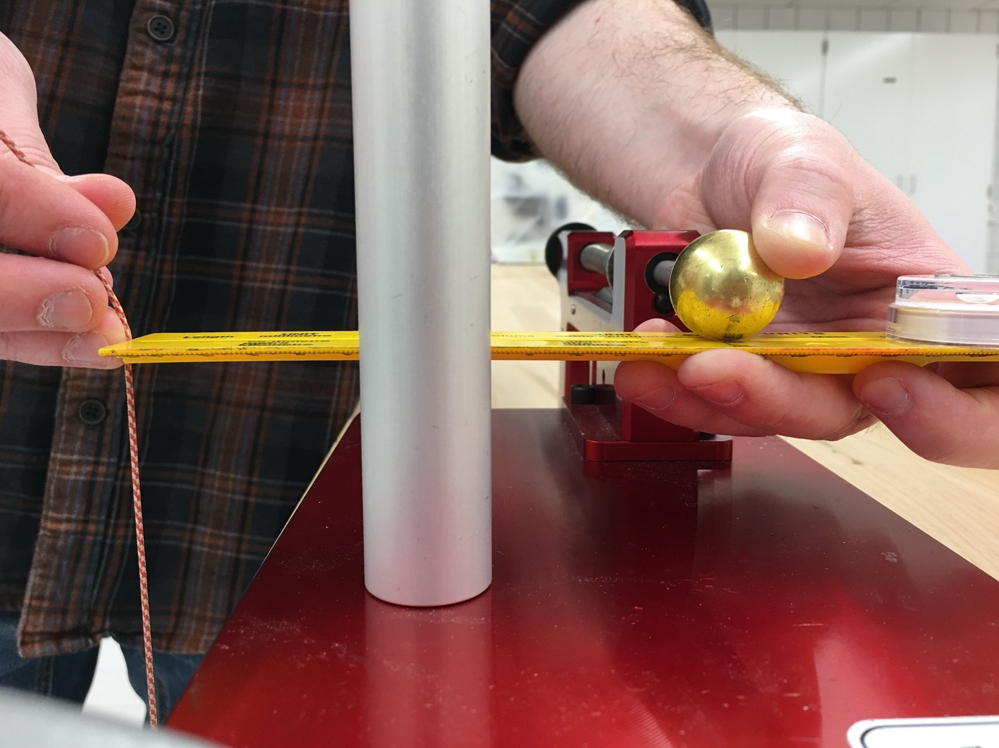
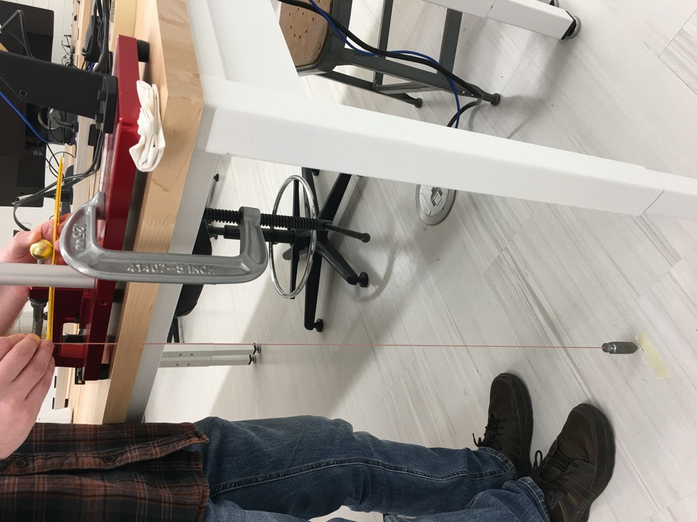
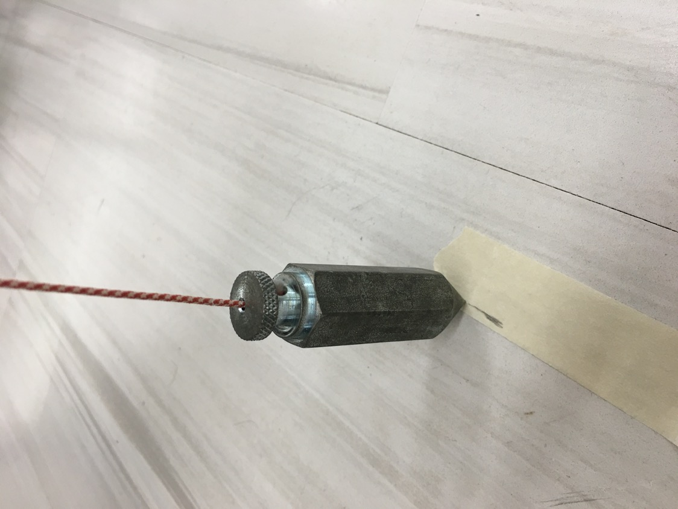
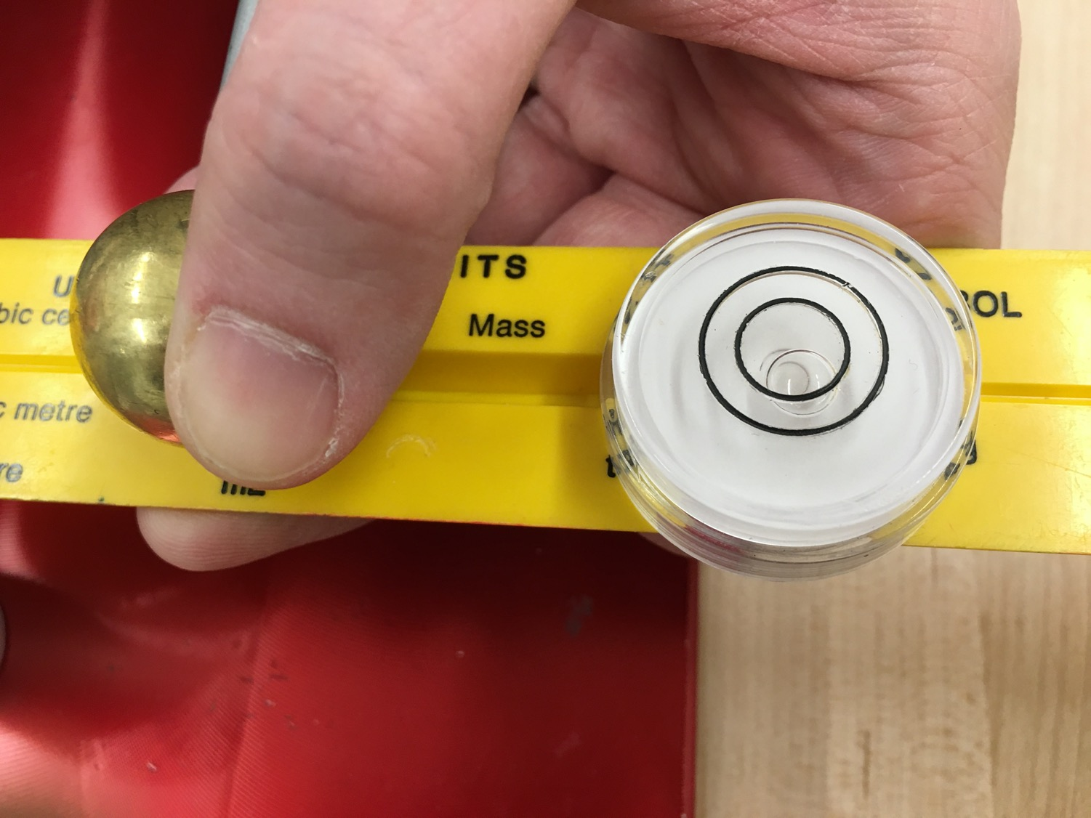
Procedure Part I – Measuring Vertical (y) Position
Finding the initial position of the ball (x direction)
Taking the vertical position five times (y direction)

Slide 14
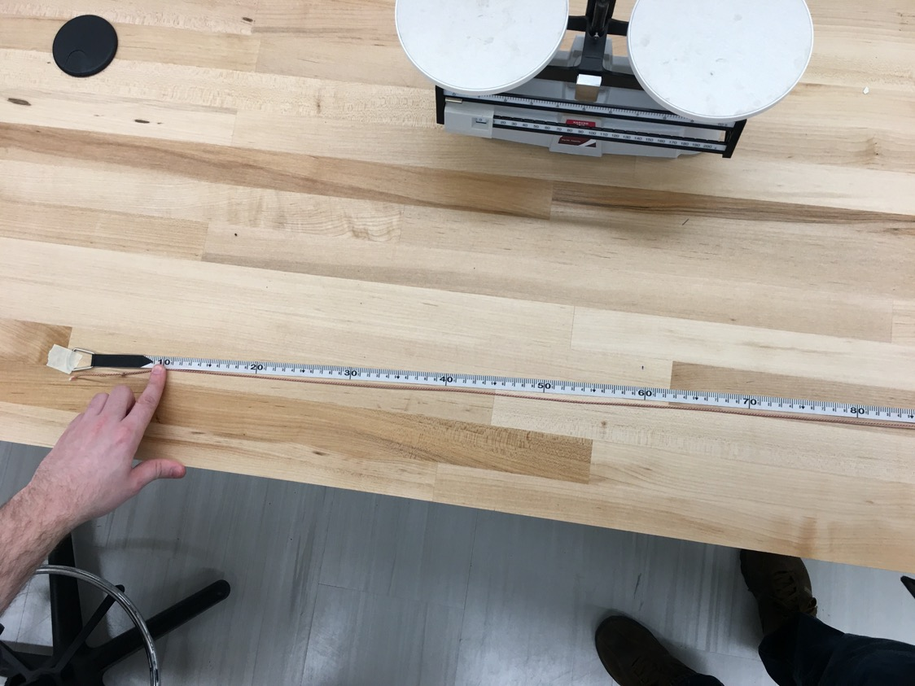
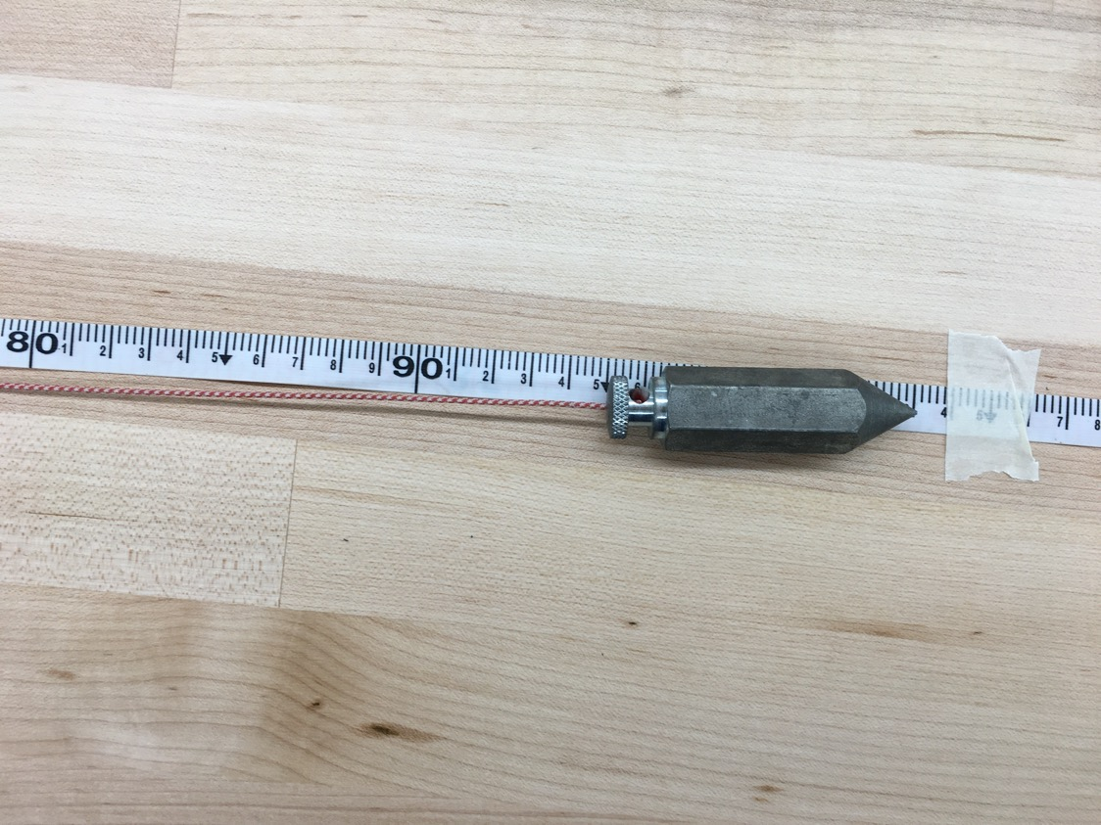
Procedure Part I - Measuring Vertical (y) Position
Finding the vertical position with the floor (continued)

Slide 15
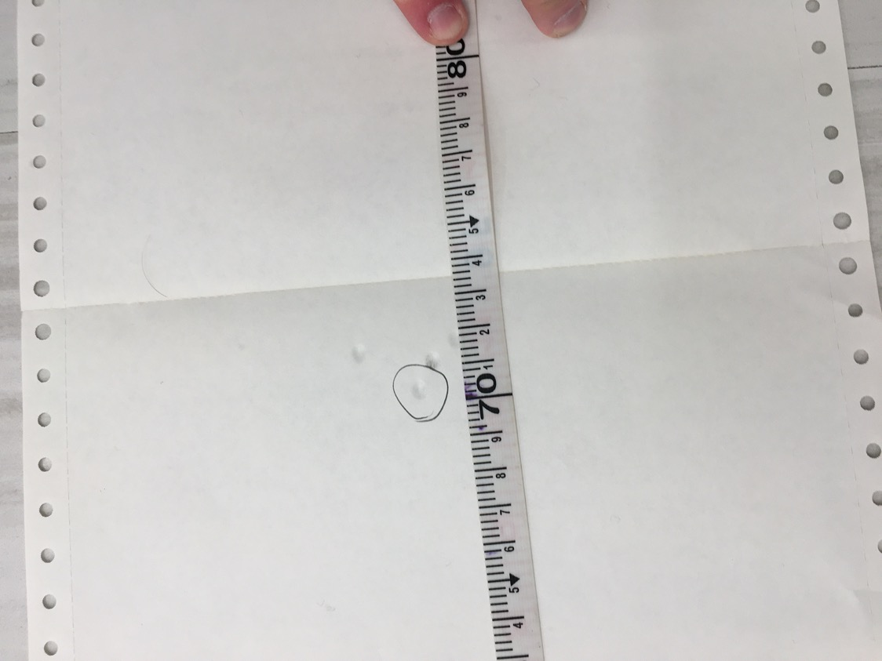
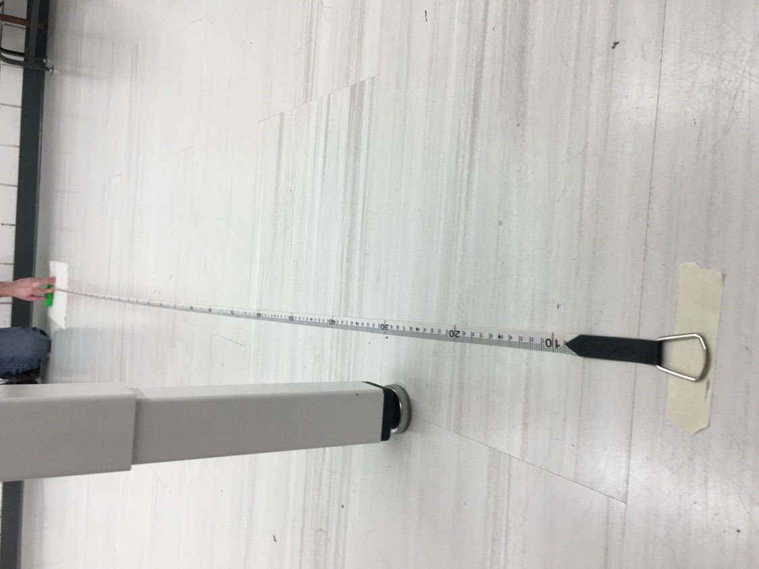
Procedure Part I - Measuring Horizontal (x) Position
After 10 trials we measure the horizontal distance travelled, X.

Slide 16
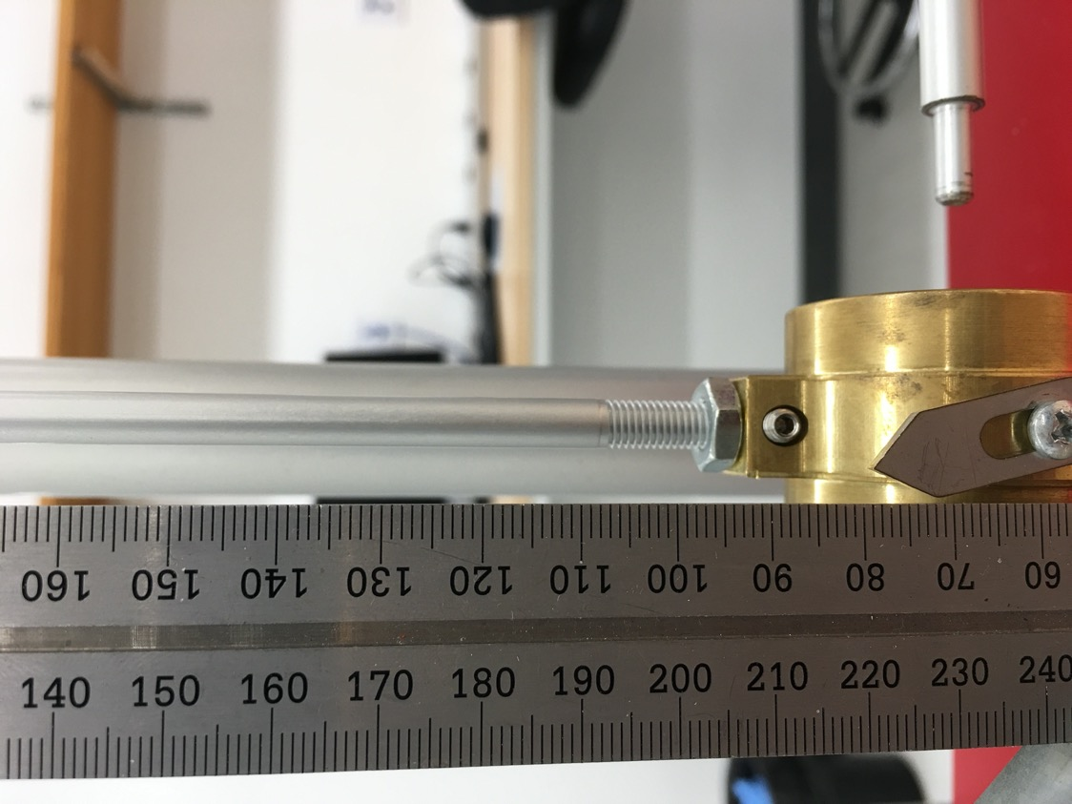
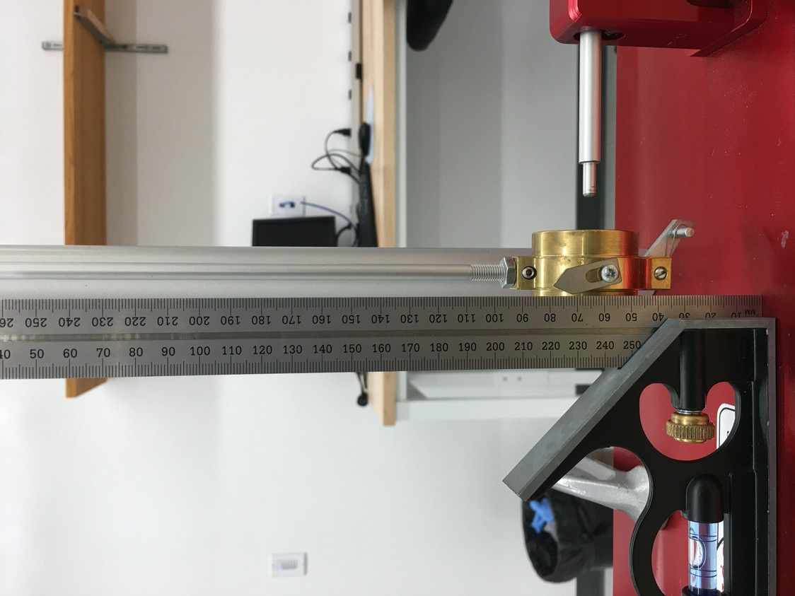
Procedure Part II – Measuring Initial Height
Measuring the initial height (five times)

Slide 17
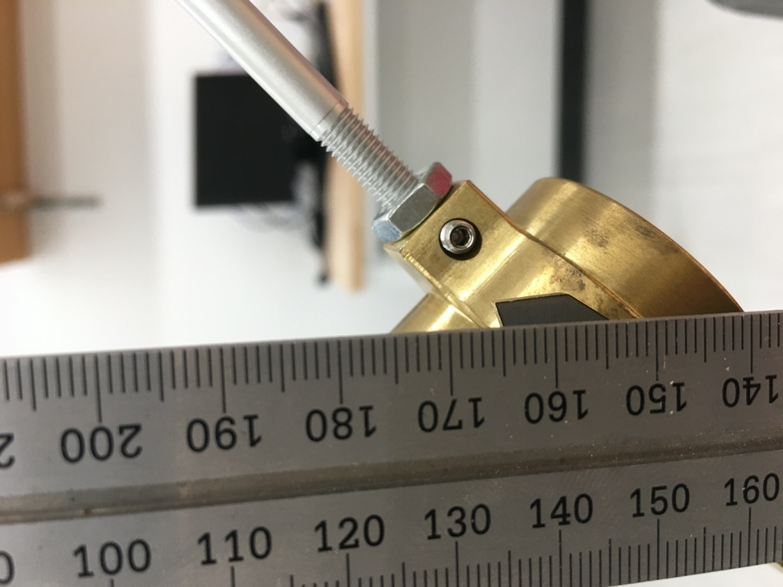
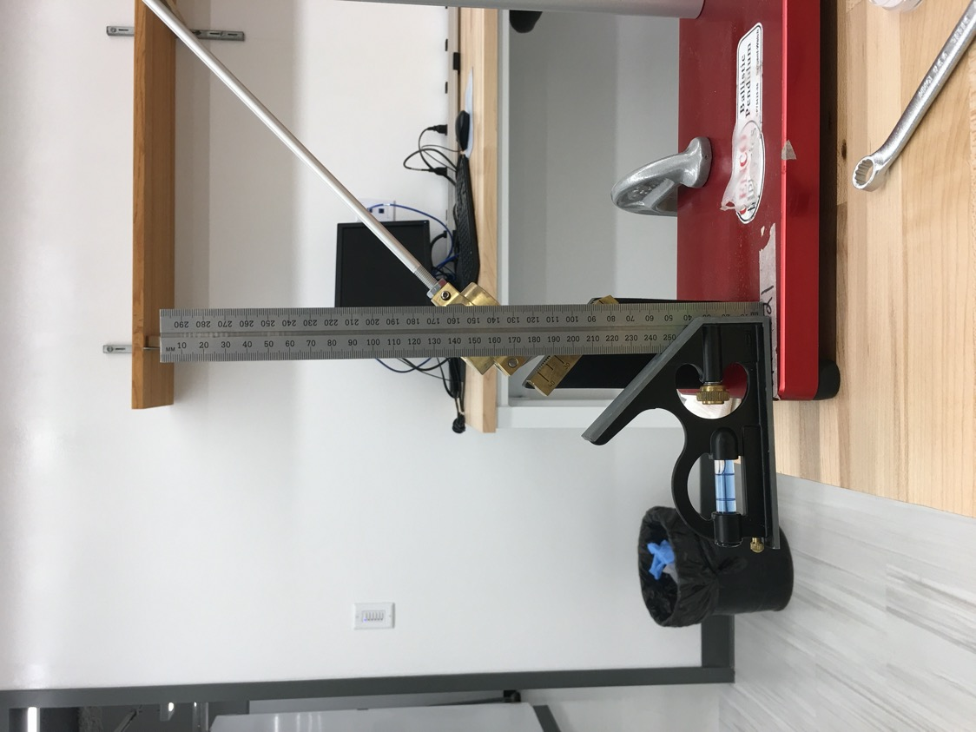
Procedure Part II - – Measuring Final Height
Measuring the final height (ten times)

Slide 18
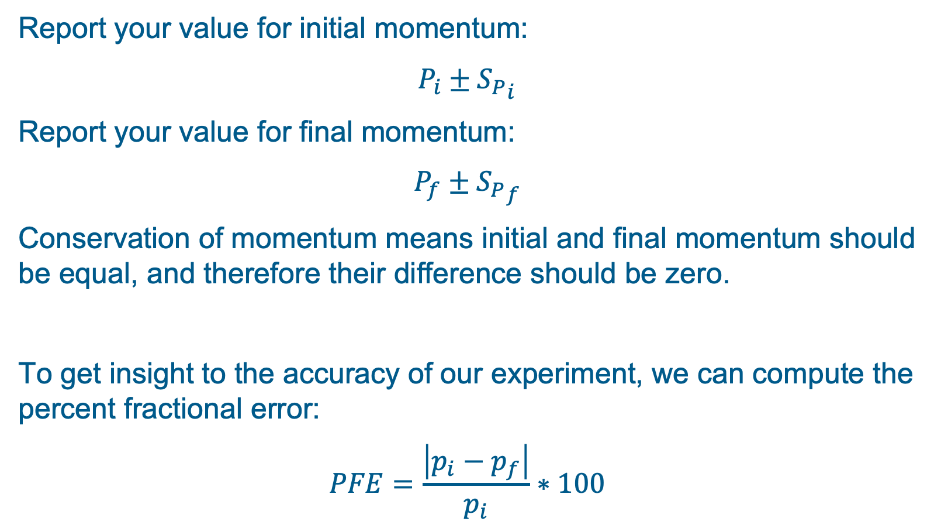
Final Results
Report your value for initial momentum:
$$P_{i}±{S_{P}}_{i}$$
Report your value for final momentum:
$$P_{f}±{S_{P}}_{f}$$
Conservation of momentum means initial and final momentum should be equal, and therefore their difference should be zero.
To get insight to the accuracy of our experiment, we can compute the percent fractional error:
$$PFE=\frac{\left|p_{i}−p_{f}\right|}{p_{i}}∗100$$

